Slide 1

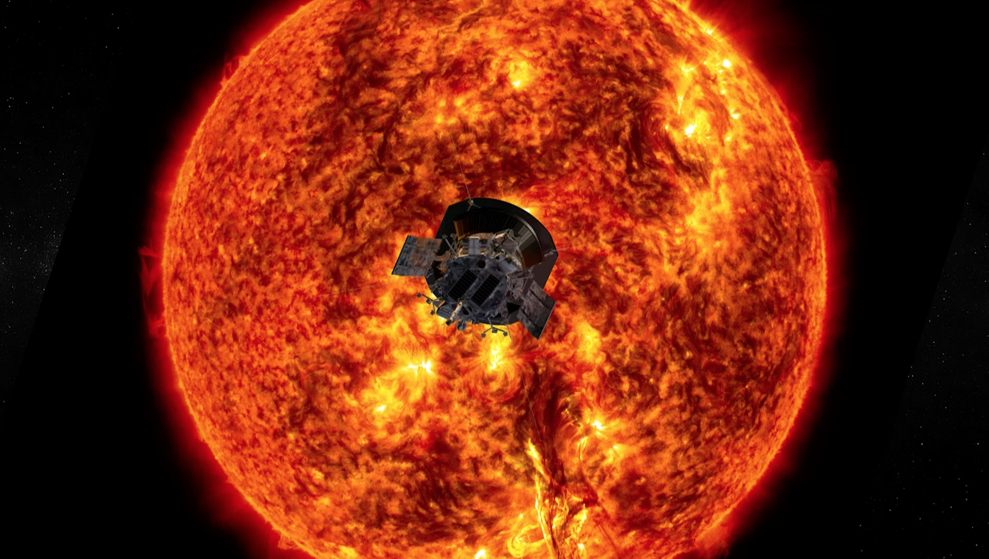
Helios Online Platform
“Looking for info on the sun, stop; Just hop onto HOP”
-Team Aelius

Slide 2



Index
Problem Statement
What is H.O.P.
Features of H.O.P.
Why This is Different
Future Enhancements
Submission Links
Team Aelius-
Akshat Srivastava - 2023- SRM IST, Chennai
Bhairav Phukan- 2023- SRM IST, Chennai (Team Leader)
Sarthak Gupta- 2023- SRM IST, Chennai
Utkarsh Ranjan- 2023- SRM IST, Chennai
Amanjit Singh- 2022- St. Xaviers College, Kolkata

Slide 3
PROBLEM STATEMENT
This challenge calls for participants to develop an interactive and immersive method (or a visualization tool) to improve public knowledge of the many spacecraft exploring the Sun – including Parker Solar Probe, which is flying closer to our star than any other mission. Our tool or method should help the public understand how the valuable data these missions provide impacts the way we live, work, and play.

Slide 4
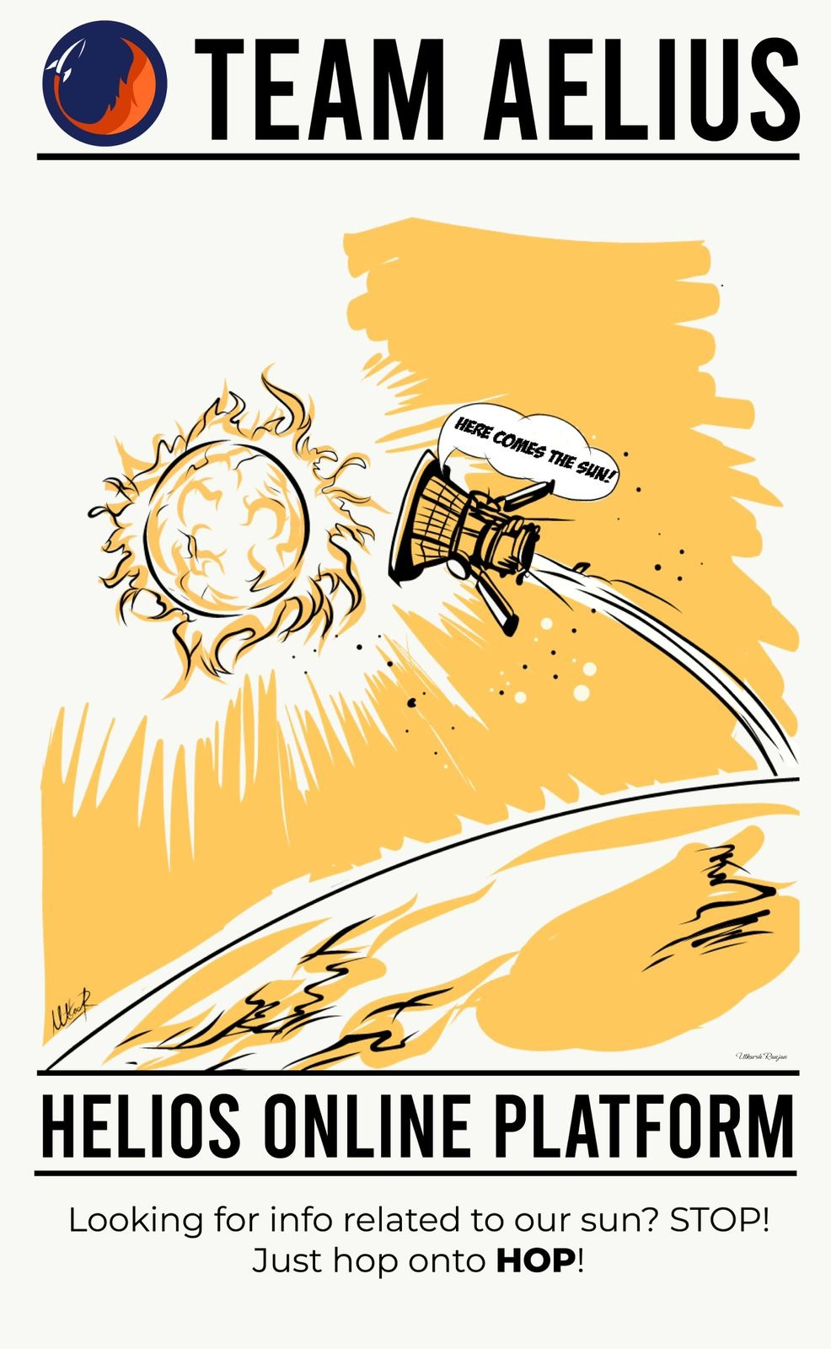
What is HOP?
In many cultures and religions the Sun has and is still being worshipped. It was used as a daily, seasonal, and annual clock by the ancient man.
The sun is the center of our solar system and it is very important to study it.
The Parker Solar Probe is a very important space probe which helps us study the sun.
Studying the Sun can also teach us more about how stars contribute to the habitability of planets throughout the universe.
We have developed the blueprint of an online platform, HOP, which will help people gain information about the ball of fire we revolve around.

Slide 5
Features of HOP
A platform where space enthusiasts can connect and share their ideas. Users can also ask questions to NASA experts.
MythBusters section, for a fun interaction and learn interesting trivia
Get info about the past, current and upcoming missions related to the sun
Quizzes and contest will be conducted and winner gets exciting prizes.
Relieve stress by listening to our playlist containing songs involving the Sun
Users can view 3-D models of all Solar missions.

Slide 6
Why is this Different-
This is a very unique idea on which we have proposed. We aim to build a blueprint of an interactive and immersive platform to improve public knowledge on the Sun and the many spacecraft exploring the Sun. Our idea bridges the gap between inspiring young space enthusiasts and the required facilities and guidance from experts to progress towards a better future in space developments.
Future Enhancements-
We can collaborate with NASA scientists and conduct virtual sessions to discuss about various space activities
We can build up a social media and content team to write various blogs about the Solar missions to promote public awareness of these exciting solar activities and how it affects daily and our future life.

Slide 7

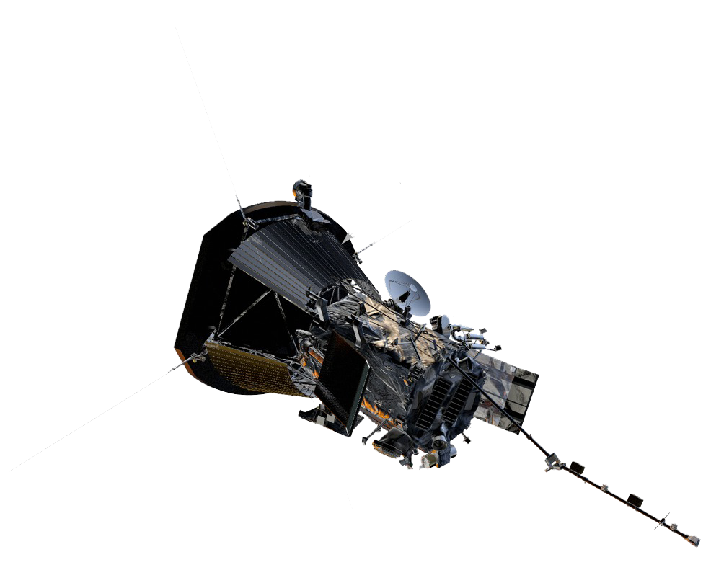
SUBMISSION LINKS
Github Link-
https://github.com/bhairavphukan03/Team-Aelius-.git
Parker Probe 3D Model File Link-
https://drive.google.com/folderview?id=176AUI9zz9S0VbKs4-x9ZIpQ8AiiuuEfr

